Slide 1
Vision to ACTION; Integrating a healthy life and career
AVTE Keynote Presentation
September 19th
You know the dreadful statistics all too well in veterinary team burnout and fatigue. We will focus on supporting your students in ways to integrate a healthy, sustainable life and career in veterinary technology. Attendees will be shown the benefits of crafting personal values, vision and mission statements, given tips in a holistic approach to wellbeing, and receive tools in establishing a healthy work-life blend.
Learning objectives
craft a personal vision statement
differentiate between wellness and wellbeing
receive tools for a healthy work/life blend

Slide 2
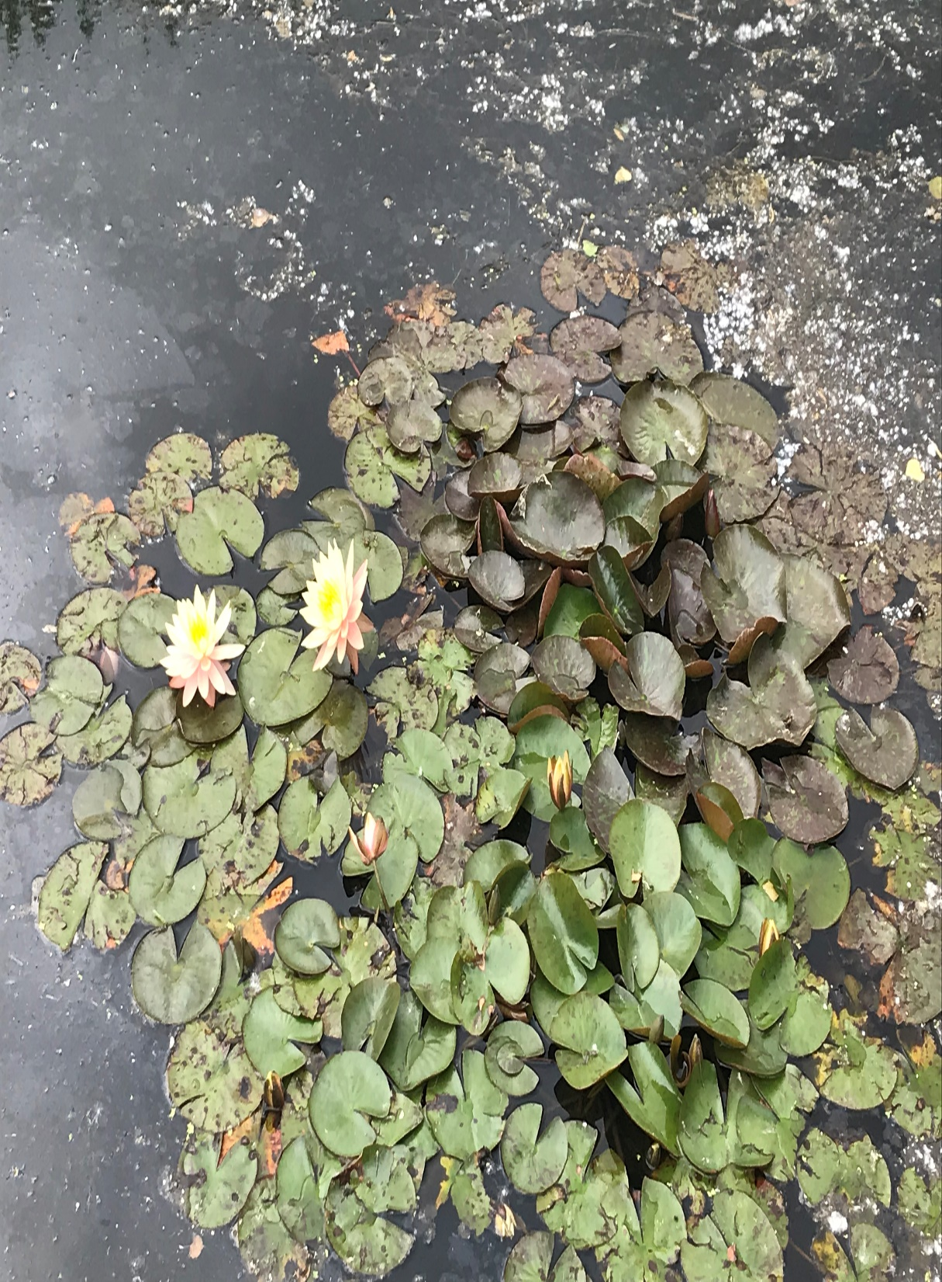
Vision to ACTION Integrating a healthy life & career
CATALYSTVetPC
CATALYST Veterinary Professional
Coaches, LLC Rebecca Rose, CVT
Littleton, CO

Slide 3
Welcome!
Vision to ACTION
Integrating a healthy life and career
Deposit Photo

Slide 4
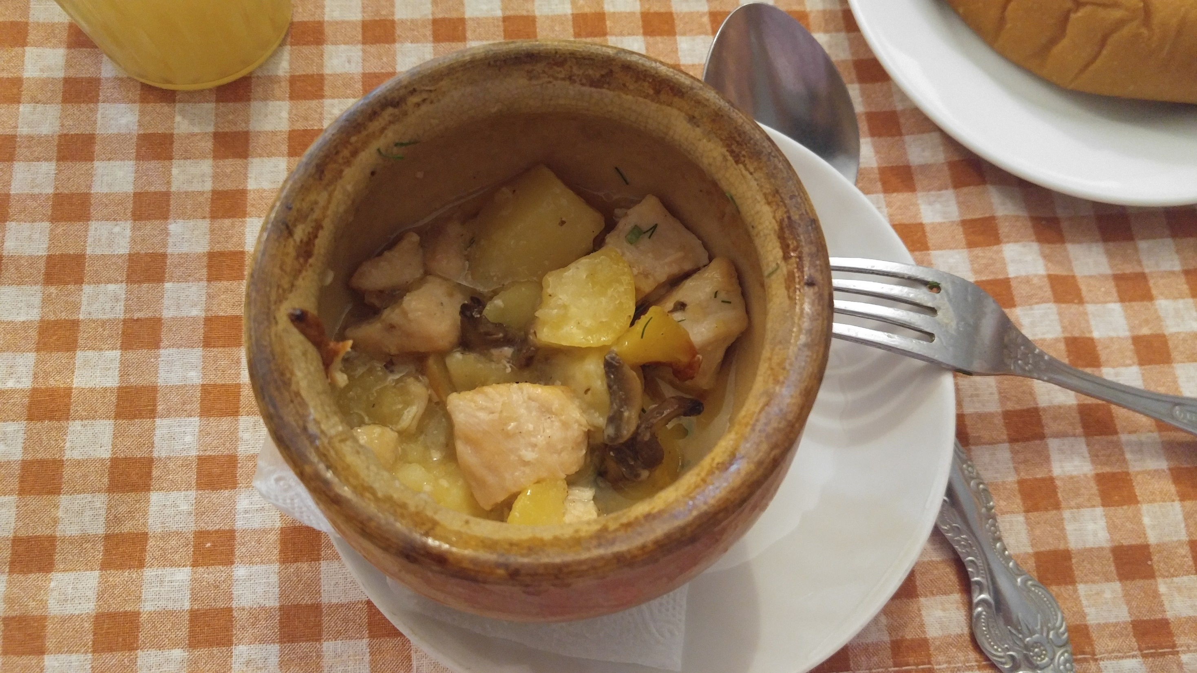
We can do better! Measure it to improve it.
32% of respondents know that no one else will take care of them but them and 25% don’t have time to take care of themselves because they are too busy helping others
34% eat unhealthy foods more than they’d like, while 23% eat OK
66% feel they drink an adequate amount of water (YES!)
Exercise percentages were all over the chart, from working out regularly to working out inconsistently or not at all
A large majority, 46% felt they got OK sleep, but it’s not always great

Slide 5
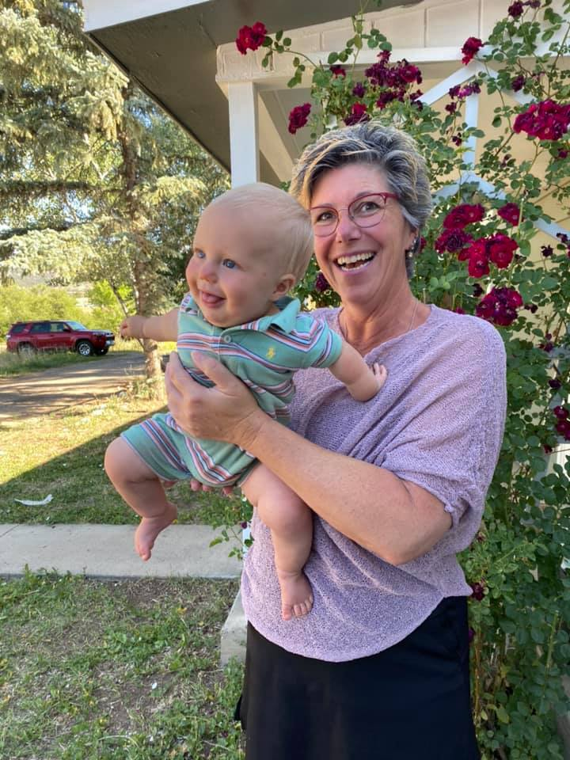
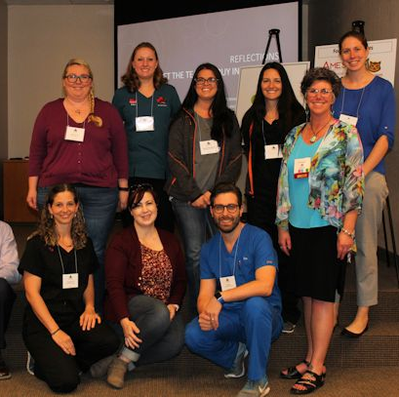
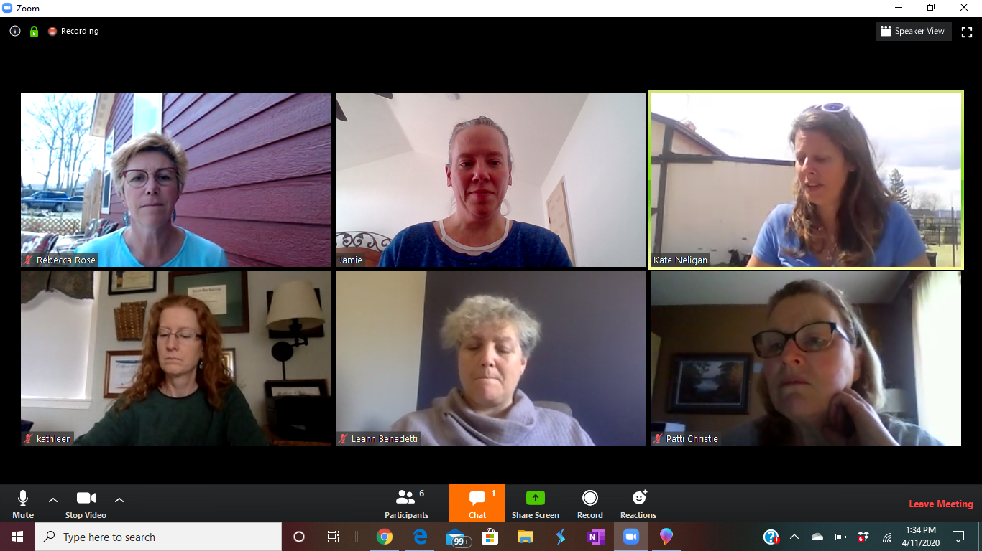
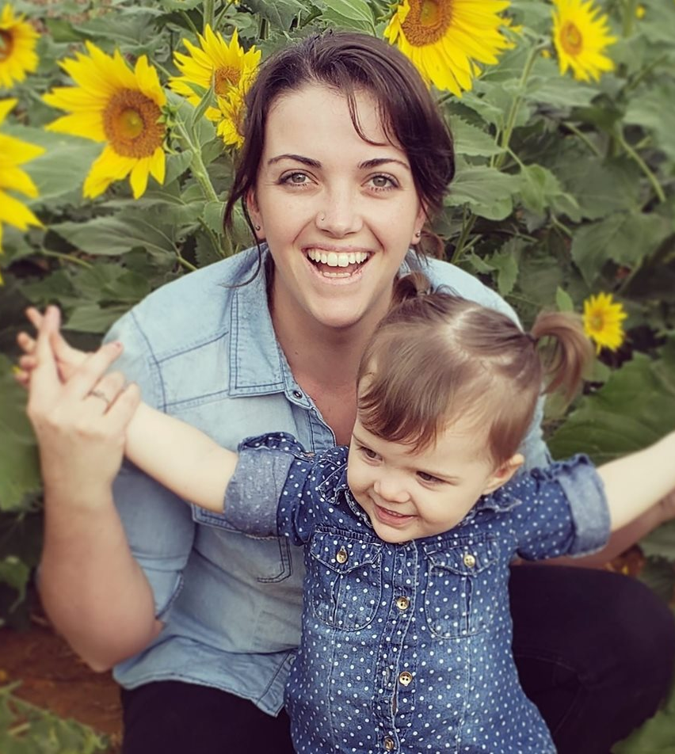
Rebecca Rose, CVT
CMC Graduate 1987
13 years Mixed Animal Practice
Association & Practice Management
Author & International presenter
CACVT President 2001
CoVMA Vet Tech of the Year 2002
CoVMA Industry Partner of the Year 2011
NAVTA Past President 2016
AVMA Speaker Communications Facilitator
CATALYST Veterinary Professional Coaches
Renley and Cayson’s Grandma!
Notes:
INTRO SLIDE
Your name
Your title
Your contact information
Picture of you doing a favorite hobby
Picture or you and your pet
Your past experience that would be relevant (worked at a veterinary practice, lived in the area, met someone at the practice prior to ICS etc )
5

Slide 6
Breathe
Grounding exercise for connecting and focus.
Deposit Photo

Slide 7
TODAY’S AGENDA
01
V-V-M Statements
02
Holistic Wellbeing
03
Work/Life Blend
04
SMART Goal
CATALYSTVetPC

Slide 8
Beginning with the end in mind
Top 3 Priorities
1.
2.
3.
Worksheet Download
Notes:
Jamie

Slide 10
We can do better! Measure it to improve it!
I have a hard time saying no.
Agree to 2 of inquiries this semester I don't like to leave things undone.
Prioritize setting an example by leaving ontime 4 days a week. I don't like to delegate.
Become a Chief Empowerment Officer of 5% of my tasks.

Slide 11
Craft your personal Values, Vision & Mission Statement

Slide 13
Worksheet
Values, Vision & Mission Worksheet
List of Values
Work/Life Blend Blog
Resources

Slide 14
Marianne Williamson’s Poem
Our Deepest Fear
Her words lift up our humanity and inspire the greatness that exists in each of us.

Slide 15
Benefits of Defining V-V-M
To clearly communicate a direction in your life.
To help make day-to-day decisions.
To keep focused.
To stay motivate.
Say “no,” gracefully.

Slide 16
BOLD, BRIGHT & COURAGEOUS!
Create without boundaries.
Allow your authentic-self to SHINE!

Slide 17
Personal Beliefs Define Our Values
Values: Beliefs we hold dear to us, allowing us to find direction and drawing to us others with similar values. When we know what we cherish, and identify aptitudes and attitudes, we draw more of that to us.
Rebecca Rose’s Values: Relationships, creativity, problem solving, sustainability & COURAGE.

Slide 18
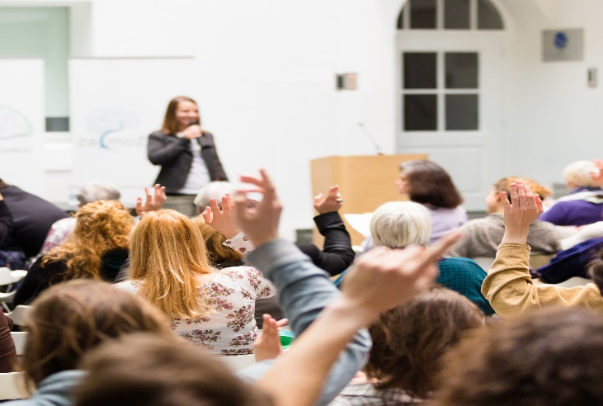
Personal Beliefs
In regard to:
Serving students (pets and people) I believe….
my personal time and satisfaction, I believe….
I hold _____________________ in high regard when it comes to my time.
I hold _____________________ in high regard when it comes to my daily happiness.

Slide 19
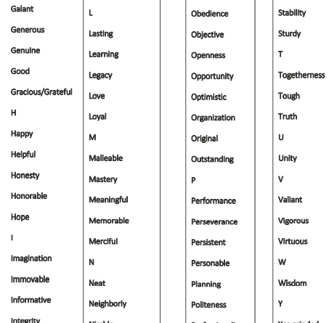
Core Values List

Slide 20
Define Vision
Vision: On the lofty side of the BIG IDEA, free of boundaries (ALL BOUNDARIES) and judgments (ALL JUDGMENTS), what I want to BE/DO that perpetuates my passion.
Rebecca Rose’s Vision: Be a physically fit, spiritually hip granny with time and resources for friends, family and grandchildren. I passionately lead by example while assisting others to find their “groove” and fulfill their personal goals and aspirations.

Slide 21
Vision
Without boundaries, in regards to advocating and serving, how do you see yourself serving in the future?

Slide 22
Define Mission
Mission: What I do on a daily basis that brings me joy, abundance, resources, financial sustainability, and connection to the people who I most align with. DOING & BEING what makes me FEEL GOOD!
Rebecca Rose’s Mission: Build masterful, passionate veterinary teams and coach individuals to offer what is best for the pet, the pet owner, the veterinary team, and the hospital.

Slide 23
Your Vision
I firmly believe in the golden rule, serenity prayer and "strive to be the best you can be". Plus there is always Plan B and this too will pass, both good and bad.

Slide 24
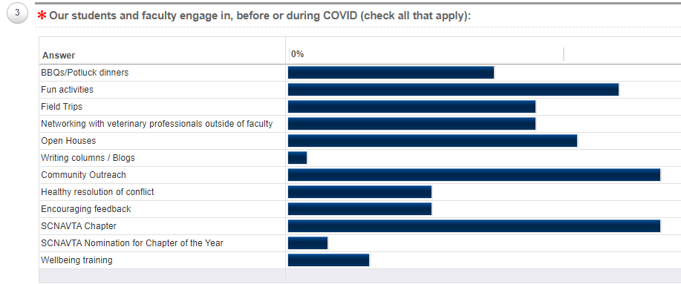
Survey Says!
We have our school’s counselor come and talk to our students about mental health and burn out.

Slide 25
The Fine Art of Self Care
I made sure to drink 8 ounces of water every hour & made regular pit stops between appointments
I took 20 minutes to eat my lunch on the picnic table outside
I left the office at 5:00 and did not take any work home with me

Slide 28
Beginning with the end in mind
Top 3 Priorities
1.
2.
3.
Notes:
Jamie

Slide 29
Wellness Wellbeing
Wellbeing begins with Wellness.

Slide 30
Holistic approach to Wellbeing

Slide 31
Take you M.E.D.S!
Meditation
Exercise
Diet/Water
Sleep
CATALYSTVetPC

Slide 32
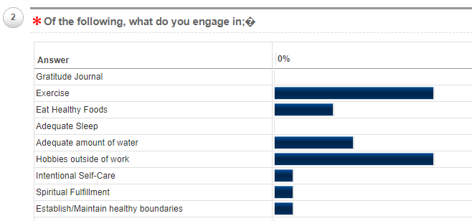
Survey Says!
None of the above, I am not very good at self care even though I know it can make all the difference. I tend to put everything else first.
Deposit Photo

Slide 33
We have been told a lie that we can balance our time and energy between career and life. How is that working for you, compartmentalizing family, hobbies, career advancement, relationships and veterinary medicine?
– CATALYST VetPC
Rebecca Rose, CVT

Slide 34
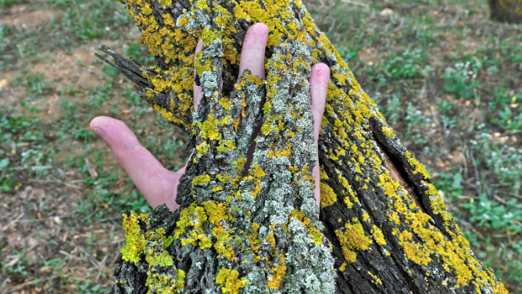

Slide 36
Challenge in Work/Life Blend

Slide 37
Solutions in Work/Life Blend

Slide 38
What is Culture, anyway? What is meant by the words “hospital culture”?
When have you experienced Work/Life blend?

Slide 39
Tools in Work/Life Blend
Life and Career are integrated
Stop compartmentalizing-stressful
Don’t over commit-Say, gracefully, “No”
Maximize efficiency – chuck Time Suckers!
Prioritize your Values, Vision & Mission
Use a calendar, keep your appointments to INCLUDE SELF-CARE
Seek help-be vulnerable
Set healthy boundaries (FREE Open Forum)
Notes:
Jamie

Slide 40
Personal
Mission
Values
Vision
Waterline

Slide 41
Beginning with the end in mind
Top 3 Priorities
1.
2.
3.

Slide 42
Top 3 Priorities
Notes:
Jamie and Rebecca

Slide 43
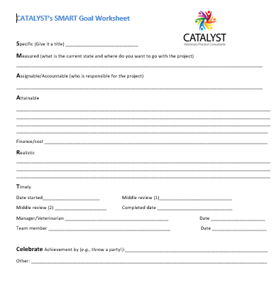
SMART Goal
S
M
A
R
T
CELEBRATE!!
Notes:
Jamie

Slide 44
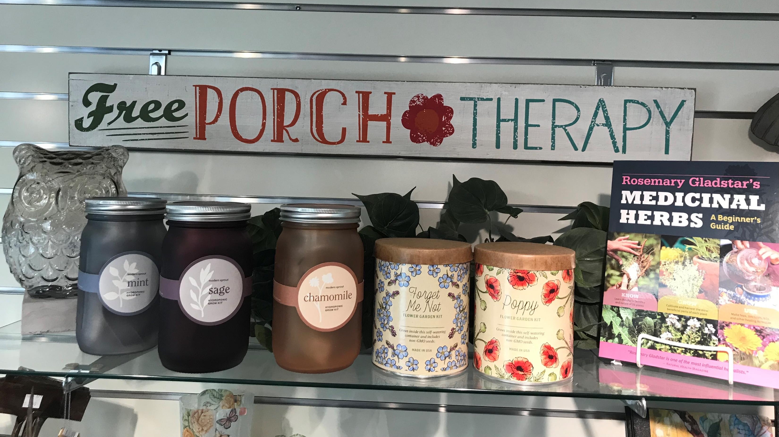
You’ve Got THIS
Craft your Values, Vision & Mission
Holistic Wellbeing
Work/Life Blend
Be kind, be mindful in developing new habits
Deposit Photo

Slide 45
Thank You
Questions?
Pixabay

Slide 46
Thank you!
Pixabay

Slide 47
Rebecca Rose, CVT
Rebecca@CATALYSTVeTPC.com
Invite to Veterinary Teams Living Well (closed Facebook page)
Sign up for CATALYST Chronicles, bimonthly eNewsletter
www.CATALYSTVetPC.com

