Slide 1
Veterinarians or Veterinary Technicians... Who Makes the Better Program Director?
Dr. Jim Hurrell and Jennifer Serling CVT

Slide 2
PollEverywhere
To participate with your iPad:
Open the PollEverywhere app on your iPad
Choose I’m Participating on the front page
Enter izzytvda under Join a presentation and tap Join
To participate with your laptop:
Open a browser and go to http://www.pollev.com/izzytvda
To participate with your mobile phone:
Text izzytvda to 37607 once to join
Notes:
Emphasize that this is the rank order of preferred participation methods
Replace the text in red with the ID that shows up at the top of your slides.

Slide 3
What State Is Everybody From? Poll

Slide 5
Are You a Veterinarian or a Veterinary Technician? Poll

Slide 7
The Program Director Combatants!

Slide 8
Veterinary Technician vs. Veterinarian

Slide 9
Statistics – AVMA-accredited Programs
Total Number of Programs – 211
Veterinary Technicians as Program Directors – 92
Veterinarians as Program Directors – 117
DL Programs – 6 DVM’s, 3 CVT’s
Following States had ALL Veterinarians as Program Directors – KY, NY, TN, VA, WI
Following State had ALL Veterinary Technicians as Program Directors – WV
North Dakota State – co-directorship of DVM & CVT

Slide 11
What Does a Veterinarian Bring to the Ring?
Strengths of a Veterinarian as a Program Director
Compassion
Decision-making skills
Interpersonal skills
Management skills
Manual dexterity
Problem-solving skills

Slide 13
What Does a Veterinary Technician Bring to the Ring?
Strengths of a Veterinary Technician as a Program Director
Patience
Respect
Integrity
Learnability
Resilience
Self-awareness

Slide 15
Qualities of an EXCELLENT Program Director
Motivator
Empathetic
Team builder
Hard worker
Not afraid to take on challenges
Organized

Slide 16
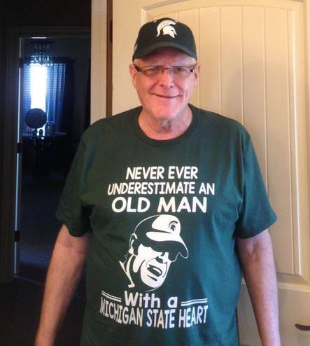
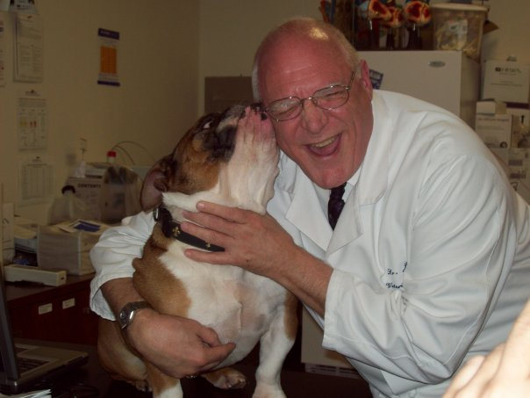
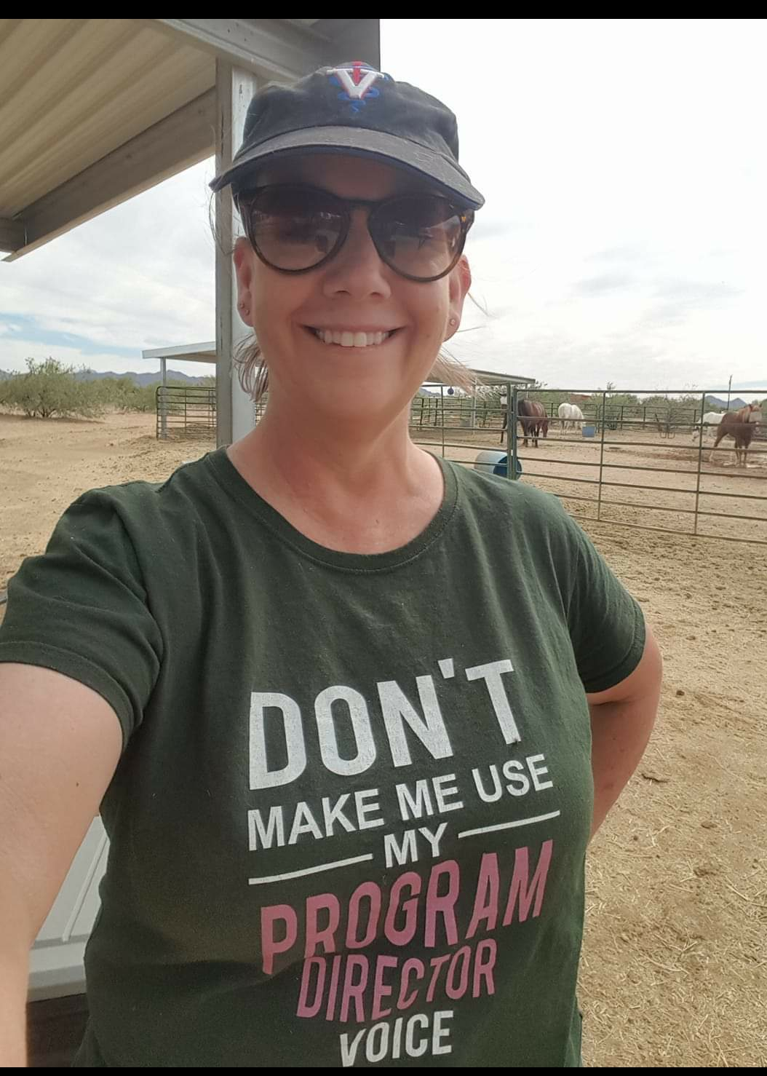
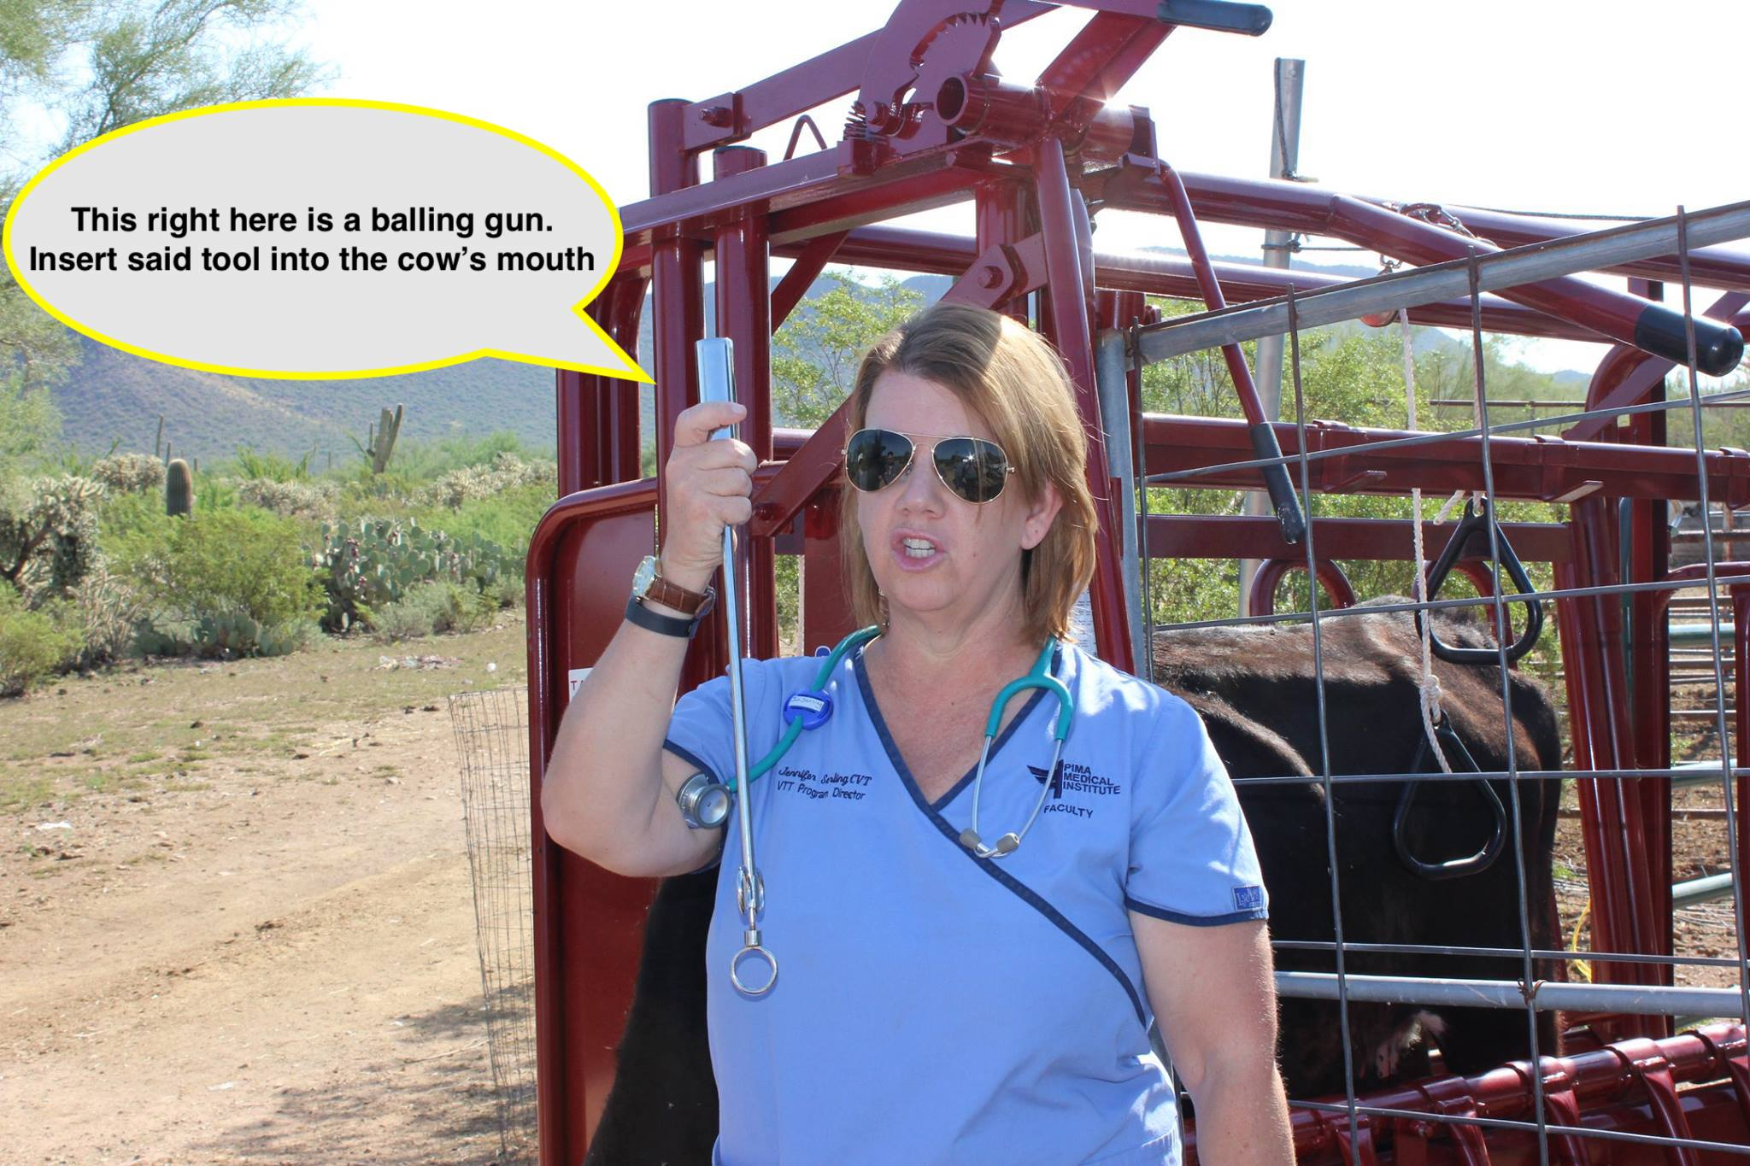
Well….. Who Wins the Fight??? ☺ Survey Says…….

Slide 18
Summary

