Slide 1
The Impact Stress has on Canine Physiological Parameters and Student Learning
Amy J. Staton, Ed.D., LVT
Isabella Matterazzo, LVT, Undergraduate Research Fellow
Hutton Fritzel, LVT, Undergraduate Research Fellow
Morehead State University
Veterinary Technology Program

Slide 2
Why is the stress of our patients so important?
Human-animal bond
Each year 1.5 million shelter animals are euthanized
670,000 of those being dogs
Ease of treatment for animals and professionals
Physiological parameters
Accuracy of laboratory results
BG
Cortisol levels
Stress leukogram

Slide 3
Why is the stress of our patients so important?
Overall well-being
Potentially contribute to Sx survival rates and speed of recovery
Potentially increase mortality
Potentially increase morbidity
Susceptibility of infection and sepsis
Impaired antibody response to vaccinations
Delayed wound healing
Gastric ulcerations
Chronic anxiety disorders
Destructive behavior

Slide 4
What is Fear Free®?
Provide veterinary professionals, pet professionals, animal welfare communities, and pet owners with the knowledge and tools to look after both a pet’s physical and emotional well-being.
By reducing patient fear, anxiety, and stress (FAS) we create a safer, more efficient work environment for the faculty, staff, and students
Improves morale of the faculty, staff, and students
Strengthens client relationships which in turn increases client retention and patient visit

Slide 5
Benefits of Fear Free®
Statistics from Bayer | Feline | Canine
Owner feel that their pet dislikes going to the vet | 51%
Owner gets stressed just thinking about going to the vet | 38%
Shows signs of stress prior to entering the clinic | 77% | 77%
Dislikes the waiting room | 73% | 63%
Reluctant to enter the exam room | 79% | 46%
Did not want to be on the exam table | 85% | 73%
Bayer HealthCare LLC, Animal Health Division, Bayer Veterinary Care Usage Study, 2011.

Slide 6
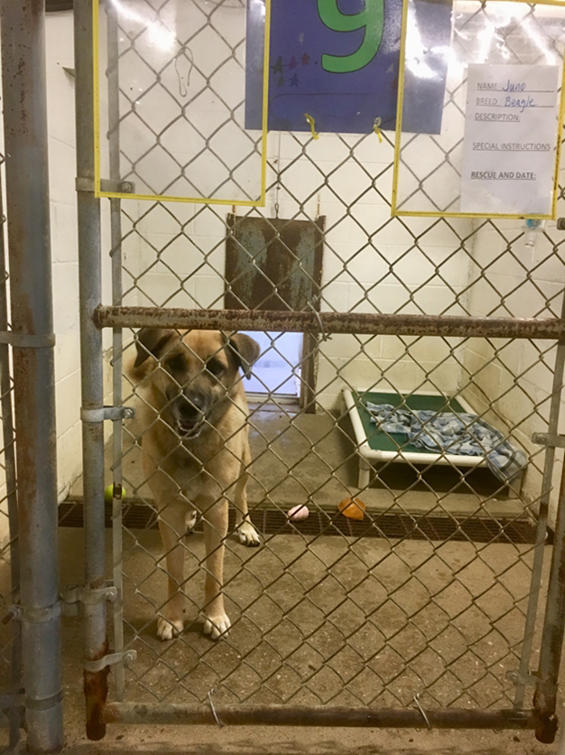
Research Facility and Subjects
Research was conducted at Saving The Animals of Rowan (STAR) Rescue facility
Subjects used in this project:
Shelter dogs of various breeds
Dogs that appeared to be healthy and considered to be an adult (between the ages of 1-7yrs)
Housing
Indoor/outdoor kennel
Raised bedding
Chew toy
Water
Fed twice a day
Released into a play yard twice a day

Slide 7
Physiological Parameters
Physiological parameters were collected before and after blood collection
Temperature
Pulse
Respiration
Blood pressure
Blood glucose
All subjects were standing while parameters were measured and blood was collected

Slide 8
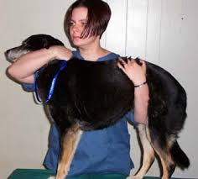
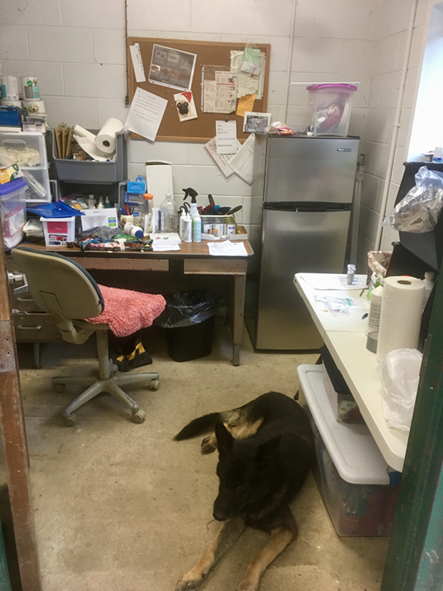
Control Group
Each subject was brought into an office space
Each subject was placed on an exam table
Each subject was handled using traditional restraint methods
All tasks were performed without using Fear Free® techniques or a reward system
Restrainer placed one arm around the neck of the subject while the opposite arm was placed under abdomen
The cephalic vein was used for blood collection site in all subjects
A 22 gauge, 1-inch needle was used on each subject

Slide 9
Test Group
Each subject was brought into an office space
Each subject was placed on an exam table
The cephalic vein was used for blood collection site in all subjects
A 22 gauge, 1-inch needle was used on each subject

Slide 10
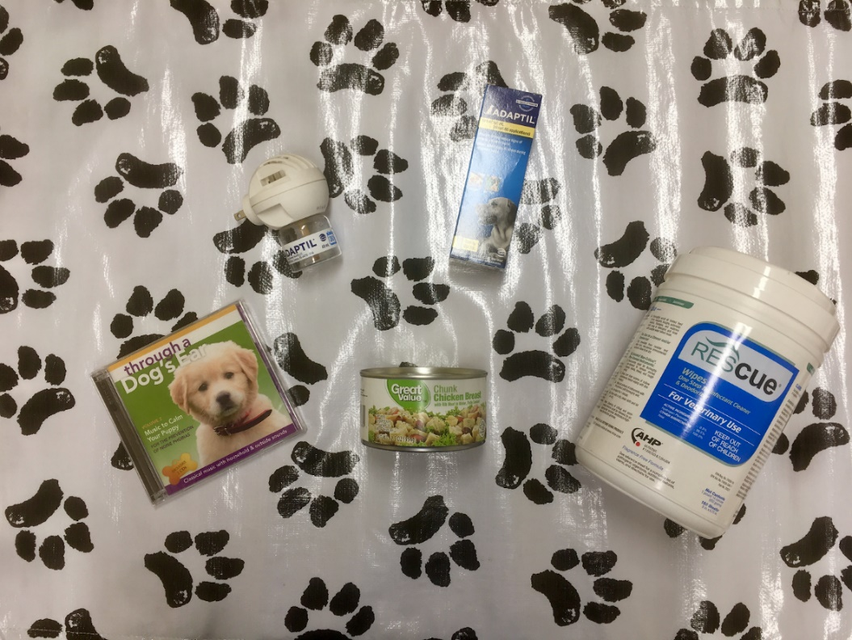
Test Group
Restrainer placed one arm around the neck of the subject while the opposite arm was placed under the abdomen
Each subject was handled using Fear Free®, low-stress techniques
Calming music
Phermonotherapy
Non-slip mats
Verbal and physical reassurance
High-value food rewards were provided during blood collection

Slide 11
Research Findings: Decrease in Physiological Parameters
Physiological Parameter | Fear Free (n=13) | Traditional (n=11)
Temperature | 54% | 18%
Pulse | 69% | 9%
Respiration | 100% | 18%
BG | 38% | 18%
MAP | 54% | 36%

Slide 12
Research Findings: Just how much…
Physiological Parameter | Fear Free (n=13)
Temperature | ↓ by 0.2°
Pulse | ↓ by 21bpm
Respiration | ↓ by 13 bpm
BG | ↓ by 13 mg/dL
MAP | ↓ by 18 mm Hg

Slide 13
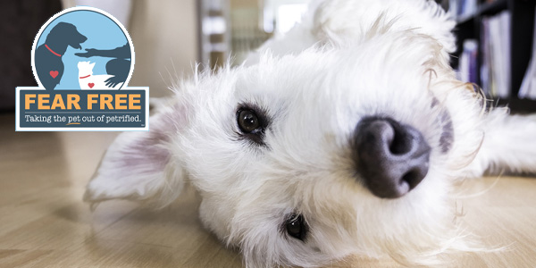
How can you achieve these results? Implementation of Fear Free®
Patience, patience, and more patience
Calming Music
Phermonotherapy
High-value food rewards
Counter condition
Verbal and physical reassurance
Non-slip mat
Low lighting
Positional compliance

Slide 14
Implementation of Fear Free®
↓ movement
↓ noise levels
Always assess body language
Basket muzzle if needed
Thoroughly disinfect all equipment
Make notes in chart of what makes pet less stressed
Kennel enrichment
Provide a safe place for animals
If pet becomes increasingly stressed or fearful stop what you are doing
Determine what is a want versus a NEED

Slide 15
Impact Fear Free has on Student Learning
Knowing the effect stress can play in a patient’s experience when they come into the clinic is essential in order to practice veterinary medicine effectively.
Making sure patient experiences are as positive as possible.
Preventing as much FAS during visits is crucial to ensure all necessary exams/tasks are performed
Making repeat visits much more enjoyable for patients, owners, and the veterinary staff.
Owners have concerns for their pets’ well-being
Do not want them to be forcibly restrained and overly stressed during routine veterinary visits.
Owners object to and often times have trouble administering sedatives such as Trazadone or Gabapentin prior to the trip to the clinic
These are often implemented in cases that require chemical intervention to decrease FAS

Slide 16
Impact Fear Free has on Student Learning
Inaccurate laboratory results:
FAS can cause false data and skewed results in patients that are overly agitated during their veterinary visits.
Fear Free® has made an impact on how the clinic I work at handles every patient that comes in for appointments.
COVID-19 restrictions and concerns

Slide 17
Fear Free Certification
Faculty and Student Certification
https://fearfreepets.com/

Slide 18
References:
Bodnariu, A. (2008). Indicators of stress and stress assessment in dogs. Lucr Stiint Med Vet, 41, 20-26.
Chlan, L., Evans, D., Greenleaf, M., & Walker, J. (2000). Effects of a single music therapy intervention on anxiety, discomfort, satisfaction, and compliance with screening guidelines in outpatients undergoing flexible sigmoidoscopy. Gastroenterology Nursing, 23(4), 148-156.
Coppola, C.L., Grandin, T., & Enns, R.M. (2006). Human interaction and cortisol: can human contact reduce stress for shelter dogs? Physiology & Behavior, 87(3), 537-541.
Dreschel, N.A. (2010). The effects of fear and anxiety on health and lifespan in pet dogs. Applied Animal Behaviour Science, 125: 157–162.
Glaser, R., & Kiecolt-Glaser, J.K. (2005). Stress-induced immune dysfunction: Implications for health. Nature Reviews Immunology, 5, 243–251.
Hekman, J., Karas, A., & Sharp, C. (2014). Psychogenic stress in hospitalized dogs: cross species comparisons, implications for health care, and the challenges of evaluation. Animals, 4(2): 331-347.
Hennessy, M.B., Davis, H.N., Williams, M.T., Mellott, C., & Douglas, C.W. (1997). Plasma cortisol levels of dogs at a county animal shelter. Physiology & Behavior, 62(3), 485- 490.
Marks, N. (2018). Fear Free Workshop. Oral Presentation at: Fear Free Workshop; Raleigh, NC.
Martin, D. (2017). The Veterinary Technician's Role in Implementing Fear Free. Today's Veterinary Nurse, 2(4).
Pageat, P., & Gaultier, E. (2003). Current research in canine and feline pheromones. Veterinary Clinics: Small Animal Practice, 33(2), 187-211.
Pet Statistics. (2019). Retrieved from https://www.aspca.org/animal-homelessness/shelter-intake- and-surrender/pet-statistics
Rodosta, L. Fear-Free techniques: Clinical behavioral evidence that they work. Oral Presentation at: CVC; 2015; Kansas City, Missouri.
Royer, C.M., Willard, M., Williamson, K., Steiner, J.M., Williams, D.A., & Davis, M. (2005). Exercise stress, intestinal permeability and gastric ulceration in racing Alaskan sled dogs. Equine Comparative Exercise Physiology, 2: 53–59.
Vitalo, A., Fricchione, J., Casali, M., Berdichevsky, Y., Hoge, E.A., Rauch, S.L., Berthiaume, F., Yarmush, M.L., Benson, H., Fricchione, G.L., & Levine, J.B. (2009). Nest Making and Oxytocin Comparably Promote Wound Healing in Isolation Reared Rats. PLoS ONE, 4: doi:10.1371/journal.pone.0005523.
Ward, P.A., Blanchard, R.J., Bolivar, V., Brown, M.J., Chang, F., Herman, J.P., & Zawistowski, S.L. (2008). Recognition and Alleviation of Distress in Laboratory Animals. National Academies Press; Washington, DC.

